Slide 1
State-transition models in R
Decision Modeling for Public Health Workshop
December 7, 2022

Slide 2
The aim of this session:
to give a short recap of the theory of state-transition models
before we dive into coding in R

Slide 3
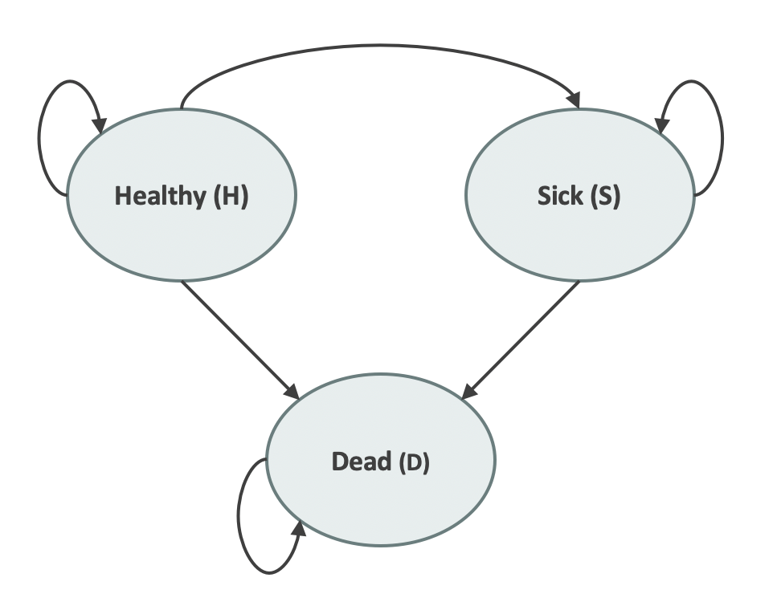
State-Transition Models
Describes disease progression using a set collectively exhaustive and mutually exclusive health states
Transitions allowed between health states with some probability
Transitions occur in discrete time cycles (months, years, etc.)

Slide 4
Cohort and individual based state-transition models
Cohort
Individuals

Slide 5

Cohort State-Transition Models
Dynamic model that reflects disease progression and other events in a cohort
Advantages:
Represents dynamic processes
Still relatively simple and so computationally efficient
Best for dynamic processes that
Can be represented with a reasonable number of states
Don’t dependent too much on individual heterogeneity (e.g., homogeneous cohort is a good approximation)
Minimal dependence on clinical history or time-in-state
Deterministic model that generate mean outcomes

Slide 6
Individual based state-transition/ “Microsimulation”
Stochastic dynamic model that simulates individuals, usually as a closed population
Advantages:
Represents stochastic dynamic processes
Most flexible model type
Can capture complex dependencies on individual features, clinical history, time-since-event
Best when a state-transition model is not sufficient
Disadvantages
Computationally intensive, but can leverage parallel computing
Data intensive

Slide 7
Cohort state-transition model
implementation in R

Slide 8
Transition Matrix Calculations
Summarize transition probabilities as a matrix
Cohort distribution at next time step calculated through matrix multiplication
To:
 | Healthy | Sick | Dead
Healthy | 0.75 | 0.20 | 0.05
Sick | 0 | 0.85 | 0.15
Dead | 0 | 0 | 1.0
From:
= A
A
x_{t+1}
=
x_{t}

Slide 9
Transition Matrix Calculations
Summarize transition probabilities as a matrix
Cohort distribution at next time step calculated through matrix multiplication
To:
 | Healthy | Sick | Dead
Healthy | 0.75 | 0.20 | 0.05
Sick | 0 | 0.85 | 0.15
Dead | 0 | 0 | 1.0
From:
= A
A
0.75
0.20
0.05
x_{t+1}
=
x_{t}
0
0.85
0.15
0
0
1.0

Slide 10
Transition Matrix Calculations
Summarize transition probabilities as a matrix
Cohort distribution at next time step calculated through matrix multiplication
To:
 | Healthy | Sick | Dead
Healthy | 0.75 | 0.20 | 0.05
Sick | 0 | 0.85 | 0.15
Dead | 0 | 0 | 1.0
From:
= A
A
x₁
x₀
0.75
0.20
0.05
0.75
0.20
0.05
=
1.0
0.0
0.0
0
0.85
0.15
0
0
1.0

Slide 11
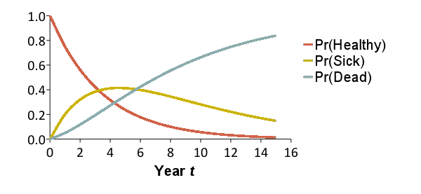
Results in a Markov trace

Slide 12
Calculate the model Outcomes
At each cycle, multiply state-specific outcomes (utilities & costs) by proportion of cohort in each state
In CEA, outcomes are discounted to reflect time preferences
Prefer benefits now, costs later
Typical discount rate of 3% per year in US

Slide 13
Individuals

Slide 14
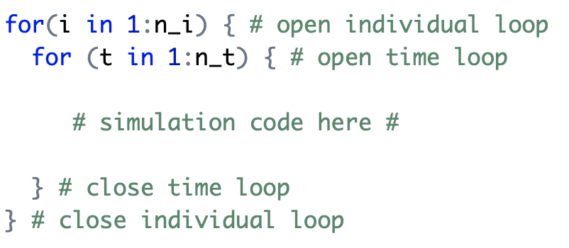
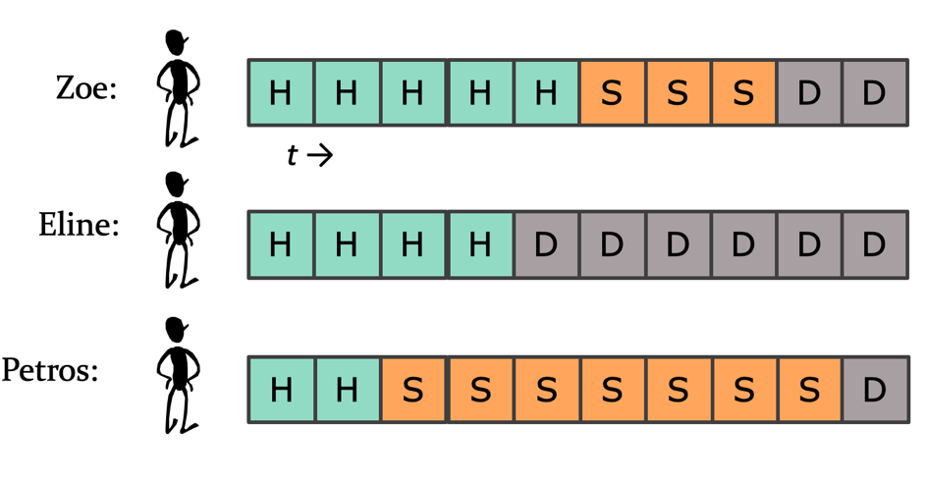
Implementation
Simulating one individual at a time is an intuitive approach…
…. however, inefficent and can make a microsimulation computationally intensive
t
i

Slide 15
Efficiency in Microsimulation
”Batch process” individual at each time step (one for-loops, function samplev )
t₁
t₂
t₃
t₄
t₅
t₆
t₇
t₈
t₉
t₁₀
Zoe:
H
H
H
H
H
S
S
S
D
D
Eline:
H
H
H
H
D
D
D
D
D
D
Petros:
H
H
S
S
S
S
S
S
S
D

Slide 16
Individual characteristics
Zoe
H
H
H
H
H
S
S
S
D
D
t →
Eline
H
H
H
H
D
D
D
D
D
D
t = 1
Petros
H
H
S
S
S
S
S
S
S
D
age
sex
height
Country of birth
time Sick
p_SD
Zoe
35
Female
1.55
Taiwan
0
--
Eline
28
Female
1.68
NL
0
--
Petros
36
Male
1.89
Greece
0
--

Slide 17
Microsimulation implementation in R
Notes:
Wrap up - deadlines & about tomorrow

Slide 18
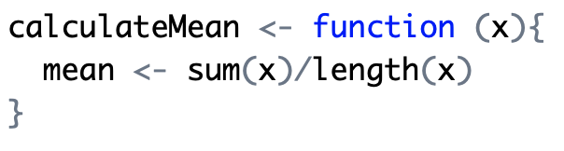
Functions

Slide 19
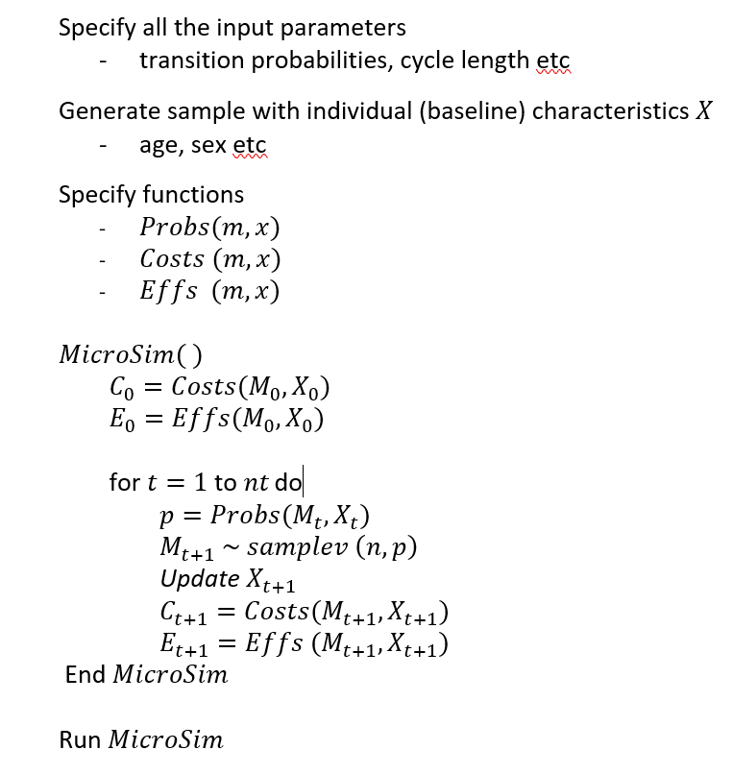
Structure of our code
Notes:
Tell the students that they can click on the links and this will direct them to the specific parts of the code.

